Slide 1

7TH ANNUAL CONFERENCE

Slide 2
Global Collaboration
Leveraging Knowledge and Exerptise

Slide 3
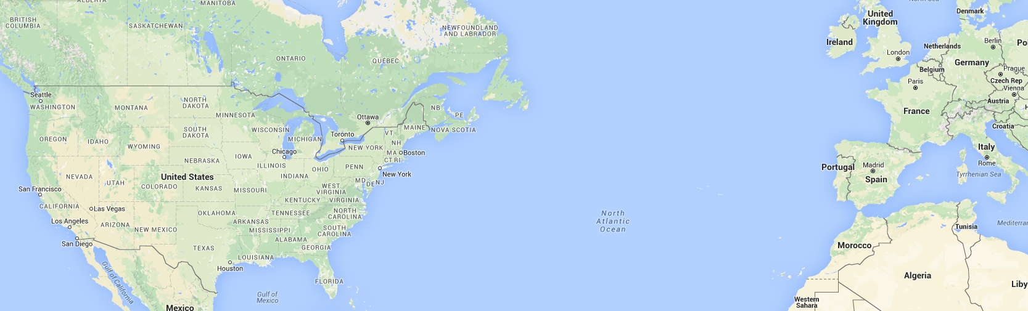
Best Practices
Performance Based Maintenance Contracts (PMC)
for the Dutch Highway Agency

Slide 4
Performance Based Contract Maturity
2000: Introduction integrated PBC
2010: Second and third generation PBC
2015: Introduction fourth generation PBC

Slide 5
Performance Based Contract Maturity
2000: Introduction integrated PBC
2010: Second and third generation PBC
2015: Introduction fourth generation PBC

Slide 6

Contract
  Procurement method
  Content & Requirements
  Contract management
If you do what you always did, you'll get what you always got

Slide 7
Risk Based Maintenance

Slide 8

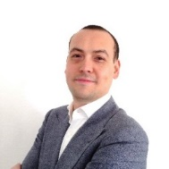
Thank you for your time!
for any questions please contact:
Tony Hendon, PE, CPESC
ARCADIS U.S., Inc.
Tony.Hendon@arcadis-us.com
Christian Jurg MSc.
ARCADIS The Netherlands N.V.
Christian.Jurg@arcadis.com

Slide 9
Thank You
7TH ANNUAL CONFERENCE

